Slide 1
Immune Cell Heterogeneity and Pathway Analysis in Breast Cancer:
Insights from deconvolution of bulk RNA Sequencing Data
By:
Yves Greatti
Reem Abu-Shamma
Lingzhu Shen

Slide 2
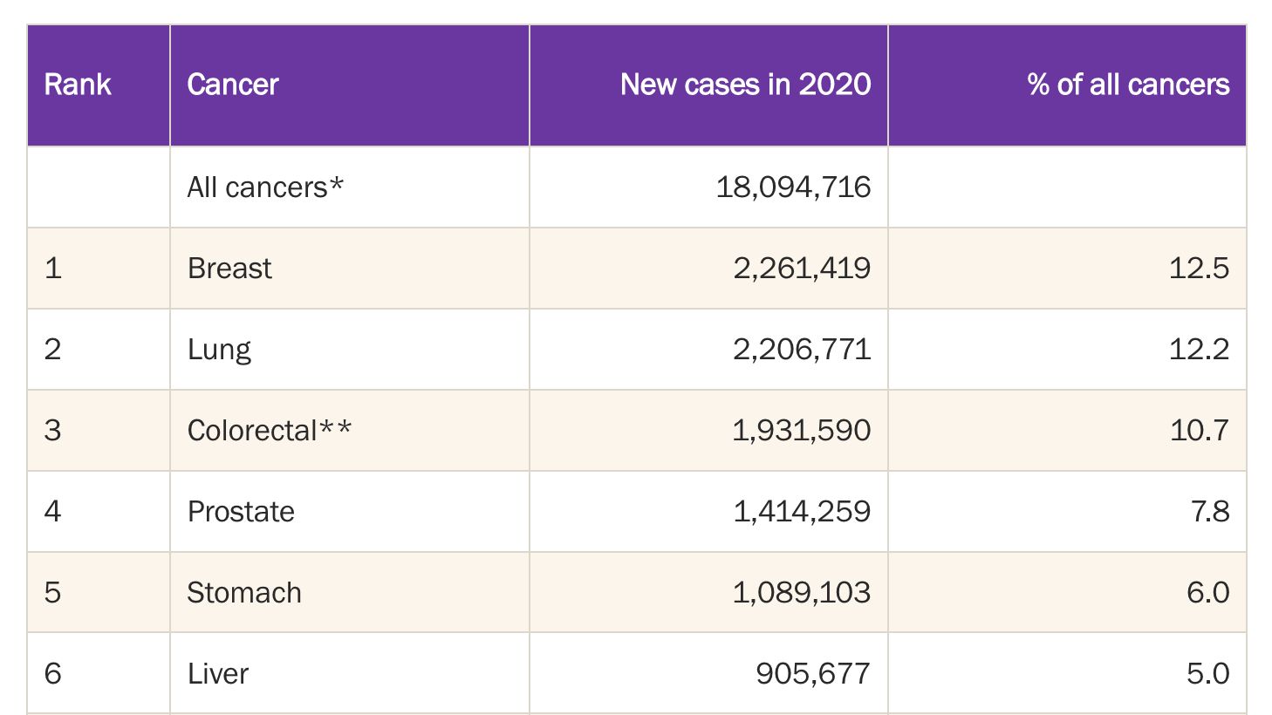
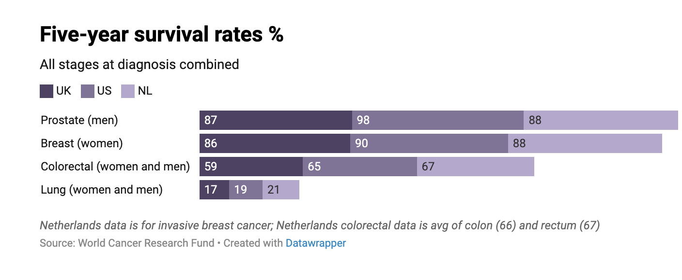
Why is Breast Cancer such a problem?
1st most common cancer in the world
[1]
Notes:
Triple-negative breast cancer (TNBC) or basal-like breast cancer: estrogen receptor (ER) (-) and progesterone receptors (PR) (-), human epidermal growth factor receptor 2 (HER2) (-) expression, is more prevalent in individuals with a BRCA1 mutation, and is the most aggressive subtype.
Luminal A breast cancer: ER (+) and PR (+), HER2 (-) and has low levels of the protein Ki-67.
Luminal B breast cancer: ER (+) and HER2 (-), and either have high levels of Ki-67 or is PR (-)
HER2-enriched breast cancer: ER (-) , PR (-), and HER2 (+)

Slide 3
Problem with Bulk-RNA Seq Data
Bulk RNA-seq data measures gene expression levels across all cells in a sample, regardless of cell type, and thus cannot distinguish between different cell types present in the sample.
Bulk RNA-seq deconvolution is an important tool for understanding the cellular complexity of biological systems.
Bulk RNA-seq deconvolution can help researchers to identify cell type-specific biomarkers or drug targets, which can have important implications for the development of new therapies related to cancer.

Slide 4
Methodology Flowchart
Bulk RNA-seq data:
TCGA BRCA cohort
ScRNA-seq:
GSE176078 (Wu et al.); tumor
GSE161529 (Pal et al.); tumor and normal
Data Collection
And Processing
Deconvolution
Multi-subject Single-cell Deconvolution (MUSiC2)
Python package
Iterative algorithm
Appropriate weighting of genes cross-samples and cross-cell
Immune Cell
Impact Analysis
XGBoost regression model and SHAP
using ESTIMATE immune score
Pathway analysis with PROGENy (R package) and decoupler (Python package)
Survival analysis with Python lifelines and scikit-survival packages
Pathway Inference
Survival Analysis
Notes:
Different R libraries to read the data and assemble together read counts with clinical information
Gene deduplication filtering and symbol conversion
Deconvolution using MUSiC: performance optimization
Immune cell impact evaluation using statistical methods and ml
Pathway Inference from deconvolution

Slide 5
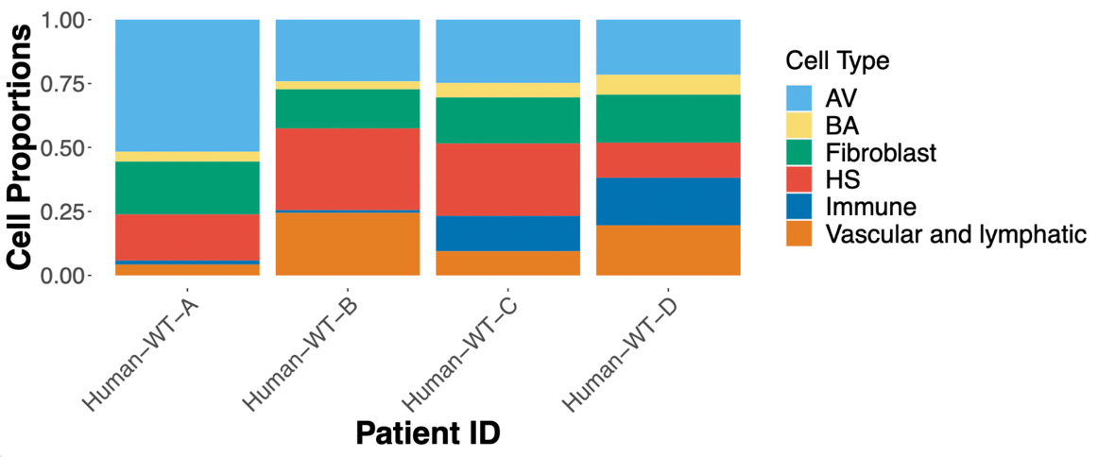
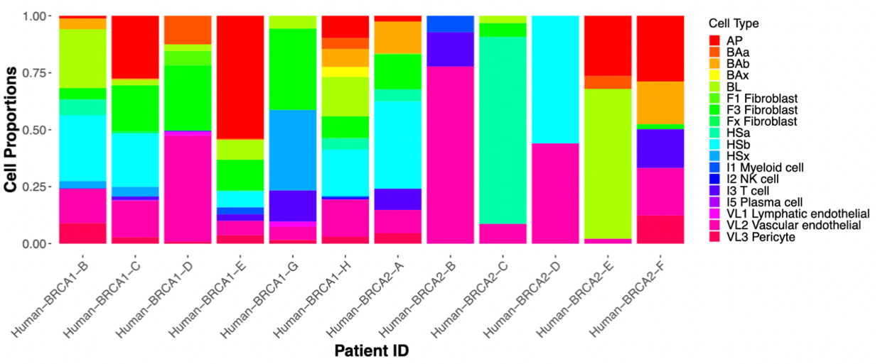
Datasets
GSE161529: study from Wu et. Al.(2021).
A single-cell and spatially resolved atlas of human breast cancers. Nature genetics, 53(9)
GSE176078: study from Pal et. Al.(2021).
A single-cell RNA expression atlas of normal, preneoplastic and tumorigenic states in the
human breast. The EMBO journal, 40(11)
Notes:
GSE161529: 430,000 cells from 52 patients. Normal tissue and different cancer subtypes (4 TNBCs, 4 BRCA1 TNBCs, 6 HER+ tumors under various conditions including different hormonal stages, preneoplastic BRCA1+/- tissue, ).
GSE176078: 26 primary tumors from three major subtypes of breast cancer (11 ER+, 5 HER2+, and 10 TNBC) and 9 major cell types, 29 minor cell types and 49 cell subtypes

Slide 6
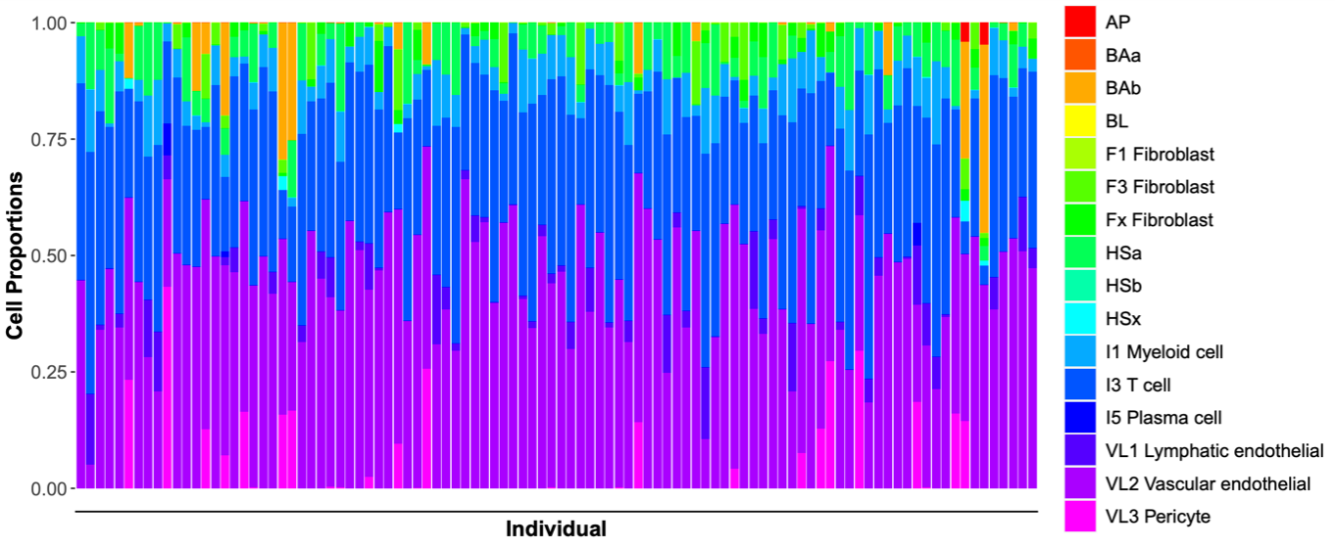
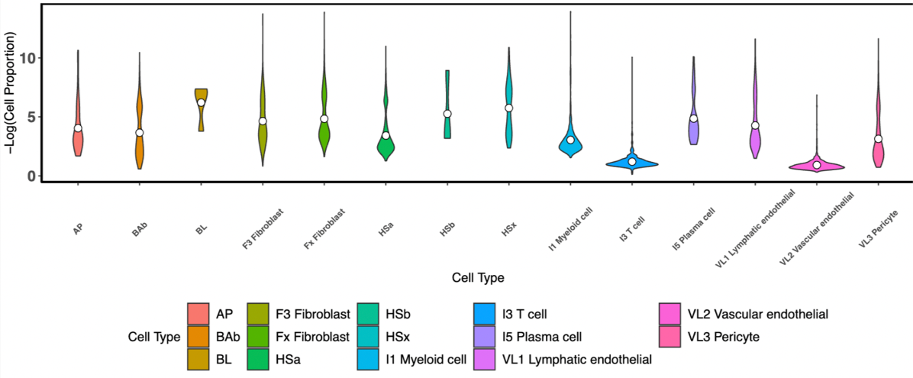
Deconvolution Results
VL2 vascular endothelial and immune I3 T cell subtypes are predominant
Levels are lower compared to HS(a,b,x) and BL cells.

Slide 7
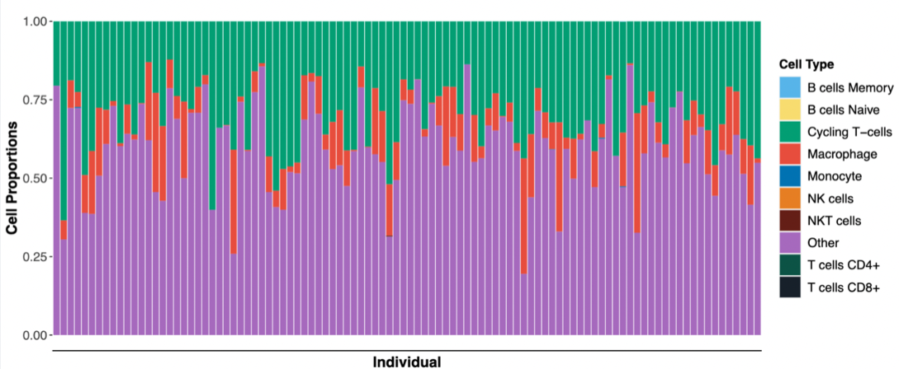
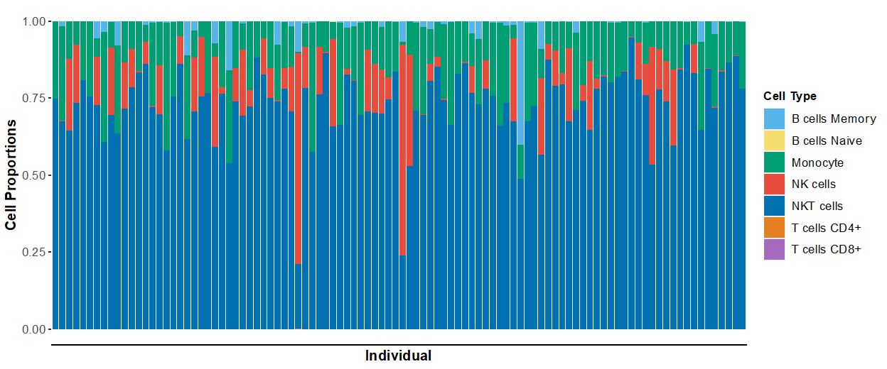
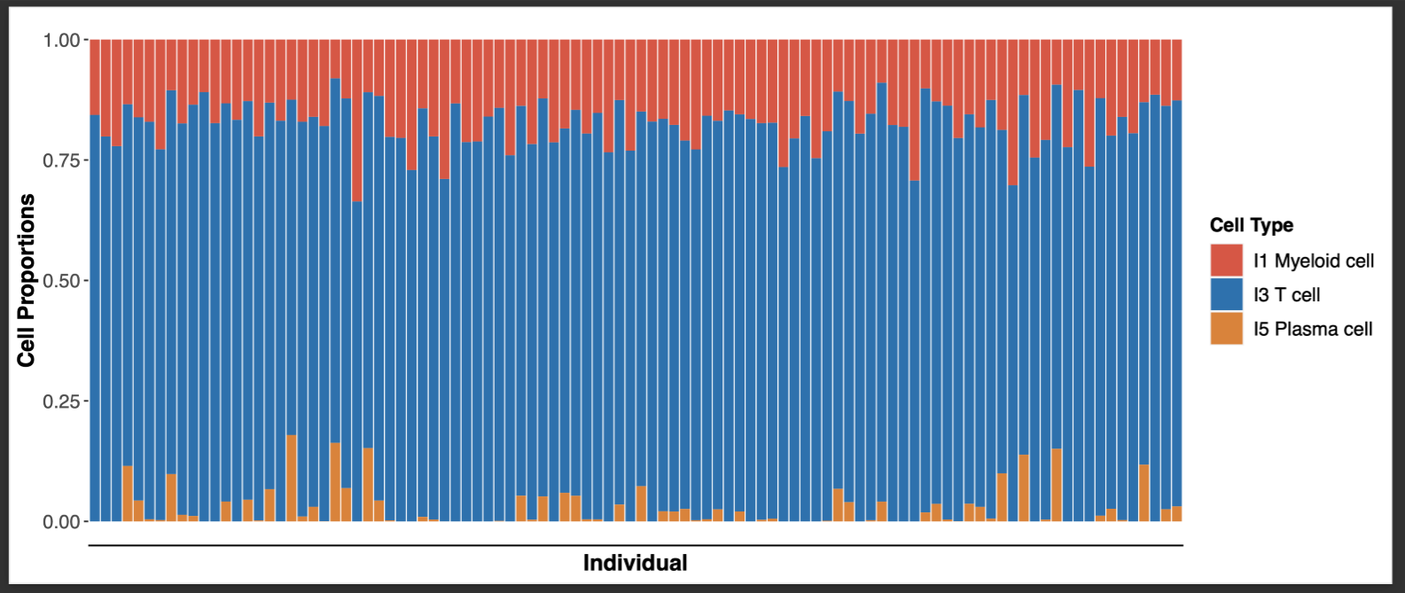
Complex interplay of different types of immune cells at play, each with its unique functions and roles in the immune response.
Top: Most prevalent are Macrophages, Cycling T cells
Middle: High number of NKT and NK cells
Bottom: T cells are predominant followed by myeloid and plasma cells
Notes:
Macrophages are a type of white blood cell that plays an important role in the immune system by engulfing and digesting foreign substances, such as bacteria and viruses. They are also involved in the process of tissue repair and can produce cytokines that help to regulate the immune response.
Cycling T cells, on the other hand, are a type of T cell that rapidly divide and expand in response to an antigen.
NKT cells are a type of T cell that share some characteristics with both T cells and natural killer (NK) cells. They play a role in regulating immune responses and can quickly respond to infections. NK cells are a type of white blood cell that is important in the early defense against viruses and cancer cells. They can directly kill infected or cancerous cells and also produce cytokines that help to stimulate the immune response.
Myeloid cells are a diverse group of cells that include neutrophils, eosinophils, basophils, and monocytes, which can differentiate into macrophages and dendritic cells. Plasma cells, meanwhile, are a type of B cell that produce and secrete antibodies, which are proteins that can recognize and bind to specific antigens, marking them for destruction by other cells in the immune system.

Slide 8
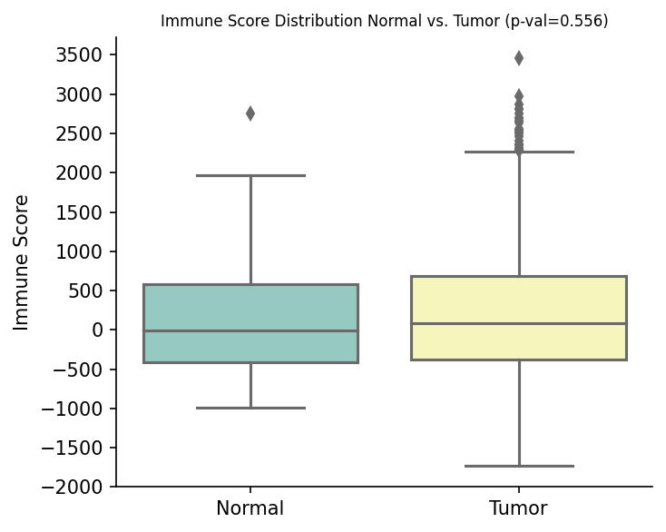
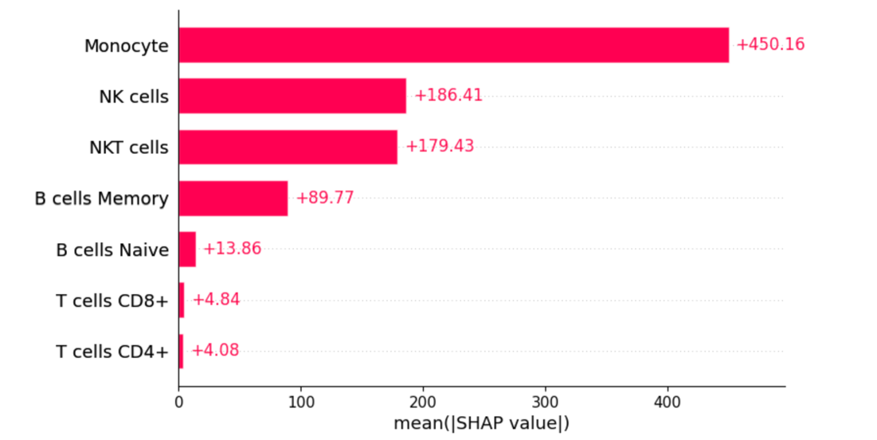
Cell Type Contribution to Immune System
Monocytes, NK, and NKT cells are the most impactful contributors to the immune score among TCGA tumor patients

Slide 9
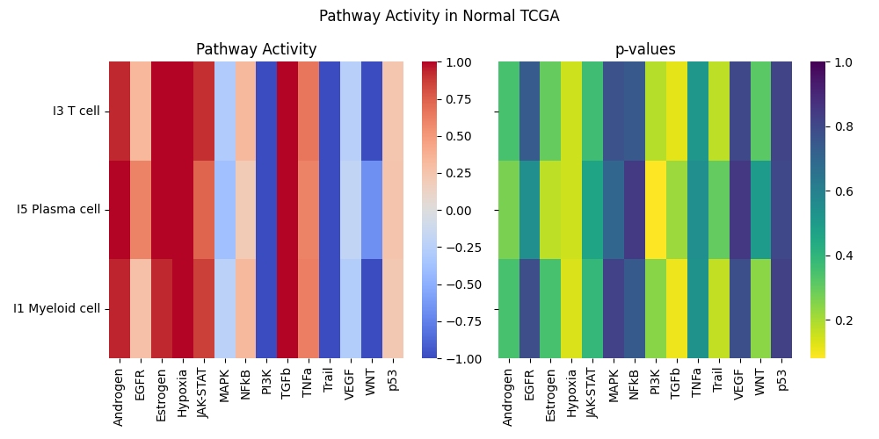
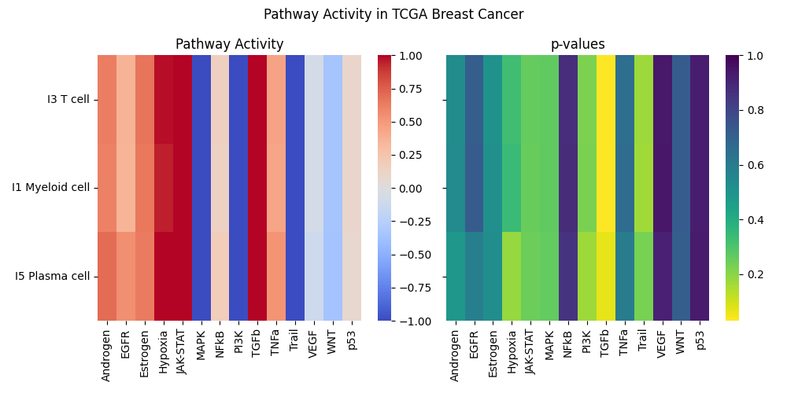
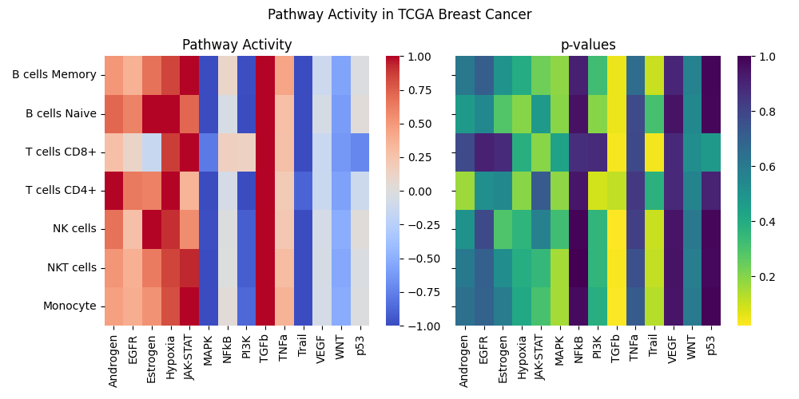
Pathway Inference
Immune cells B, T, and NK cells exhibit a trend of higher activity in pathways that regulate immune responses, such as TGF-β.
Lower activity in pathways that induce apoptosis, such as Trail or MAPK pathway.
Potential prognostic markers found: ID1, ID3, COM, PMEPA1, SMAD7 (TGF-β) and RHEBL1, SMIM3, GPR18, RAB37, RNF175 (Trail)

Slide 10
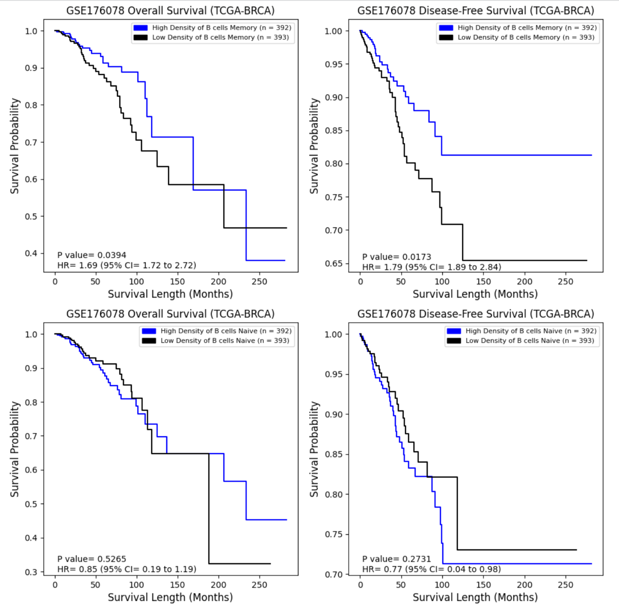
Correlation between cell type and survival outcome [1]
Tumor patients with high levels of memory B cells had significantly lower overall survival (OS) and significantly higher disease-free survival (DFS) when compared to patients with low levels of memory B cells.

Slide 11
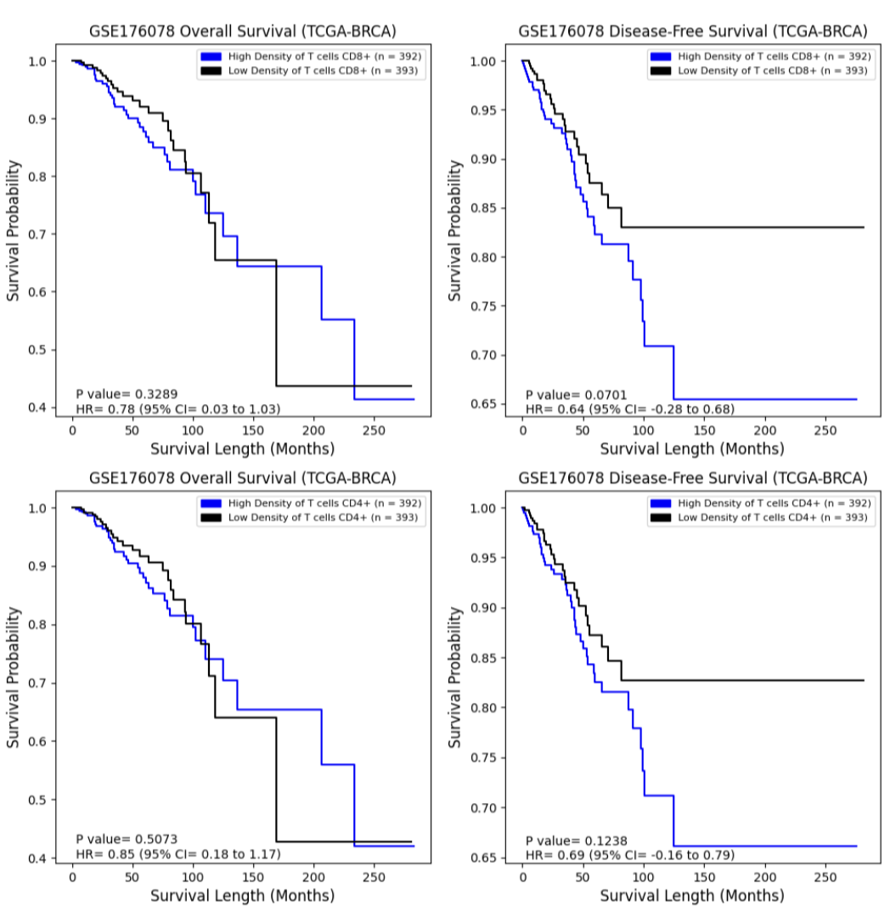
Correlation between cell type and survival outcome [2]
High levels of CD8+ T cells showed lower DFS that was near significant (p-val = 0.07).

Slide 12
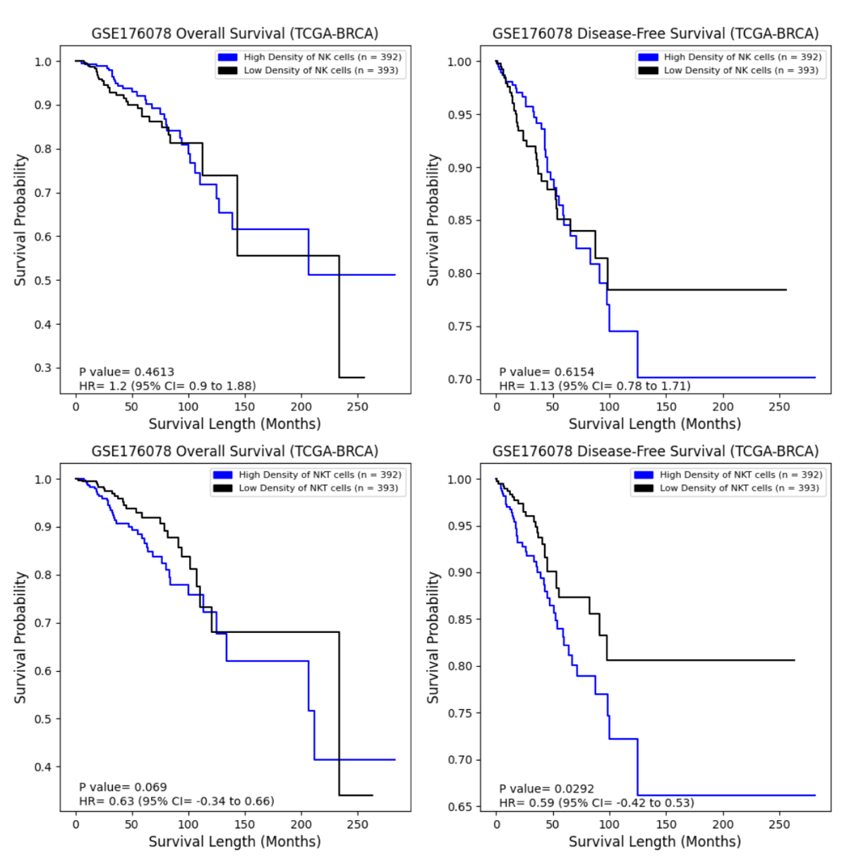
Correlation between cell type and survival outcome [3]
High levels of NKT cells had significantly lower DFS, while low levels of NKT cells showed higher OS that was near significant (p-val = 0.07)

Slide 13
References
[1]“Cancer Survival Statistics: World Cancer Research Fund International.” WCRF International, 11 July 2022,
https://www.wcrf.org/cancer-trends/cancer-survival-statistics/.
Gray, G. K., Li, C. M., Rosenbluth, J. M., Selfors, L. M., Girnius, N., Lin, J. R., Schackmann, R. C. J., Goh, W. L., Moore, K., Shapiro, H. K., Mei, S., D'Andrea, K., Nathanson, K. L., Sorger, P. K., Santagata, S., Regev, A., Garber, J. E., Dillon, D. A., & Brugge, J. S. (2022). A human breast atlas integrating single-cell proteomics and transcriptomics. Developmental cell, 57(11), 1400–1420.e7. https://doi.org/10.1016/j.devcel.2022.05.003
Fan, J., Lyu, Y., Zhang, Q., Wang, X., Li, M., & Xiao, R. (2022). MuSiC2: cell-type deconvolution for multi-condition bulk RNA-seq data. Briefings in bioinformatics, 23(6), bbac430. https://doi.org/10.1093/bib/bbac430
Huang, Ruichao, et al. “Combining Bulk RNA-Sequencing and Single-Cell RNA-Sequencing Data to Reveal the Immune Microenvironment and Metabolic Pattern of Osteosarcoma.” Frontiers in Genetics, vol. 13, Oct. 2022, p. 976990. DOI.org (Crossref), https://doi.org/10.3389/fgene.2022.976990.
Lai, Wenwen, et al. “Integrated Analysis of Single‐cell RNA‐seq Dataset and Bulk RNA‐seq Dataset Constructs a Prognostic Model for Predicting Survival in Human Glioblastoma.” Brain and Behavior, vol. 12, no. 5, Apr. 2022, p. e2575. PubMed Central, https://doi.org/10.1002/brb3.2575.
Manoharan, Malini, et al. “A Computational Approach Identifies Immunogenic Features of Prognosis in Human Cancers.” Frontiers in Immunology, vol. 9, Dec. 2018, p. 3017. PubMed Central, https://doi.org/10.3389/fimmu.2018.03017.
Qi, Zongtai, et al. “Single-Cell Deconvolution of Head and Neck Squamous Cell Carcinoma.” Cancers, vol. 13, no. 6, Mar. 2021, p. 1230. DOI.org (Crossref), https://doi.org/10.3390/cancers13061230.
Gonzalez, H., Hagerling, C., & Werb, Z. (2018). Roles of the immune system in cancer: from tumor initiation to metastatic progression. Genes & development, 32(19-20), 1267–1284. https://doi.org/10.1101/gad.314617.118
Man, Y. G., Stojadinovic, A., Mason, J., Avital, I., Bilchik, A., Bruecher, B., Protic, M., Nissan, A., Izadjoo, M., Zhang, X., & Jewett, A. (2013). Tumor-infiltrating immune cells promoting tumor invasion and metastasis: existing theories. Journal of Cancer, 4(1), 84–95. https://doi.org/10.7150/jca.5482
McDonald, K. A., Kawaguchi, T., Qi, Q., Peng, X., Asaoka, M., Young, J., Opyrchal, M., Yan, L., Patnaik, S., Otsuji, E., & Takabe, K. (2019). Tumor Heterogeneity Correlates with Less Immune Response and Worse Survival in Breast Cancer Patients. Annals of surgical oncology, 26(7), 2191–2199. https://doi.org/10.1245/s10434-019-07338-3
Orrantia-Borunda E, Anchondo-Nuñez P, Acuña-Aguilar LE, Gómez-Valles FO, Ramírez-Valdespino CA. Subtypes of Breast Cancer. In: Mayrovitz HN. editor. Breast Cancer. Brisbane (AU): Exon Publications. Online first 22 Jun 2022.
Wu, S. Z., Al-Eryani, G., Roden, D. L., Junankar, S., Harvey, K., Andersson, A., Thennavan, A., Wang, C., Torpy, J. R., Bartonicek, N., Wang, T., Larsson, L., Kaczorowski, D., Weisenfeld, N. I., Uytingco, C. R., Chew, J. G., Bent, Z. W., Chan, C. L., Gnanasambandapillai, V., Dutertre, C. A., … Swarbrick, A. (2021). A single-cell and spatially resolved atlas of human breast cancers. Nature genetics, 53(9), 1334–1347. https://doi.org/10.1038/s41588-021-00911-1
Pal, B., Chen, Y., Vaillant, F., Capaldo, B. D., Joyce, R., Song, X., Bryant, V. L., Penington, J. S., Di Stefano, L., Tubau Ribera, N., Wilcox, S., Mann, G. B., kConFab, Papenfuss, A. T., Lindeman, G. J., Smyth, G. K., & Visvader, J. E. (2021). A single-cell RNA expression atlas of normal, preneoplastic and tumorigenic states in the human breast. The EMBO journal, 40(11), e107333. https://doi.org/10.15252/embj.2020107333
De Silva, D., Kunasegaran, K., Ghosh, S., & Pietersen, A. M. (2015). Transcriptome analysis of the hormone-sensing cells in mammary epithelial reveals dynamic changes in early pregnancy. BMC developmental biology, 15, 7. https://doi.org/10.1186/s12861-015-0058-9
Gusterson, B., & Eaves, C. J. (2018). Basal-like Breast Cancers: From Pathology to Biology and Back Again. Stem cell reports, 10(6), 1676–1686. https://doi.org/10.1016/j.stemcr.2018.04.023
https://journals.plos.org/plosone/article?id=10.1371/journal.pone.0280851#pone.0280851.ref008
Zitvogel, L., Tesniere, A. & Kroemer, G. Cancer despite immunosurveillance: immunoselection and immunosubversion. Nat Rev Immunol 6, 715–727 (2006). https://doi.org/10.1038/nri1936
Goff, S. L., & Danforth, D. N. (2021). The Role of Immune Cells in Breast Tissue and Immunotherapy for the Treatment of Breast Cancer. Clinical breast cancer, 21(1), e63–e73. https://doi.org/10.1016/j.clbc.2020.06.011
Bhat-Nakshatri P, Gao H, Sheng L, McGuire PC, Xuei X, Wan J, Liu Y, Althouse SK, Colter A, Sandusky G, Storniolo AM, Nakshatri H. A single-cell atlas of the healthy breast tissues reveals clinically relevant clusters of breast epithelial cells. Cell Rep Med. 2021 Mar 16;2(3):100219. doi: 10.1016/j.xcrm.2021.100219. PMID: 33763657; PMCID: PMC7974552.
Gonzalez, H., Hagerling, C., & Werb, Z. (2018). Roles of the immune system in cancer: from tumor initiation to metastatic progression. Genes & development, 32(19-20), 1267–1284. https://doi.org/10.1101/gad.314617.118
Shen, M., Wang, J., & Ren, X. (2018). New Insights into Tumor-Infiltrating B Lymphocytes in Breast Cancer: Clinical Impacts and Regulatory Mechanisms. Frontiers in immunology, 9, 470. https://doi.org/10.3389/fimmu.2018.00470
Chen, C. H., Seguin-Devaux, C., Burke, N. A., Oriss, T. B., Watkins, S. C., Clipstone, N., & Ray, A. (2003). Transforming growth factor β blocks Tec kinase phosphorylation, Ca2+ influx, and NFATc translocation causing inhibition of T cell differentiation. The Journal of experimental medicine, 197(12), 1689-1699.
Batlle E, Massagué J. Transforming Growth Factor-β Signaling in Immunity and Cancer. Immunity. 2019 Apr 16;50(4):924-940. doi: 10.1016/j.immuni.2019.03.024. PMID: 30995507; PMCID: PMC7507121.
Staal, F., Luis, T. & Tiemessen, M. WNT signalling in the immune system: WNT is spreading its wings. Nat Rev Immunol 8, 581–593 (2008). https://doi.org/10.1038/nri2360
Liu, Y., Shepherd, E. & Nelin, L. MAPK phosphatases — regulating the immune response. Nat Rev Immunol 7, 202–212 (2007). https://doi.org/10.1038/nri2035
Debien, V., De Caluwé, A., Wang, X. et al. Immunotherapy in breast cancer: an overview of current strategies and perspectives. npj Breast Cancer 9, 7 (2023). https://doi.org/10.1038/s41523-023-00508-3
Galli, F., Aguilera, J.V., Palermo, B. et al. Relevance of immune cell and tumor microenvironment imaging in the new era of immunotherapy. J Exp Clin Cancer Res 39, 89 (2020). https://doi.org/10.1186/s13046-020-01586-y

Slide 14
EXTRA

Slide 15
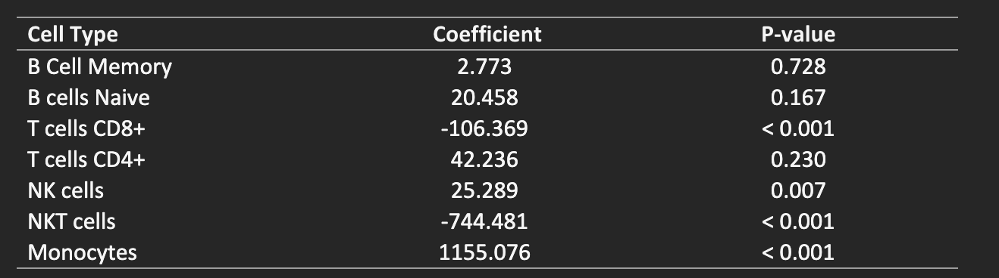
XGBOOST Model Coefficients and p-values

